Slide 1
Visual Recognition using Deep Learning
2025 Spring, Homework 3
Release Date: 2025/04/16 12:00
Notes:
‹#›

Slide 2
Homework 3
Deadline: 23:59, 05/07 (Wed), 2025
Participate the competition (80%): Instance Segmentation
Participant the competition on the CodaBench and get the highest score as possible. (70%)
Code reliability: GitHub (10%)
Report and code (20%): Document your method and findings.
Report
In PDF format and written in English. (5pt penalty)
Introduction to your method (e.g., data pre-processing, model architecture, hyper-parameters)
Conduct additional experiments to further improve the model and analyze their results.
Code
Zip your code (.py) alone with report - Submit to E3.
You should also put your code on your GitHub repository and provide the link in the report.

Slide 3
Links
Link to the dataset
Sample code
Link to the competition

Slide 4
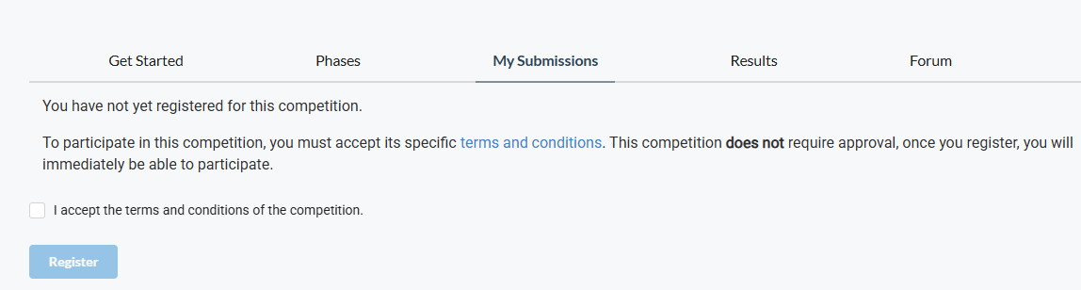
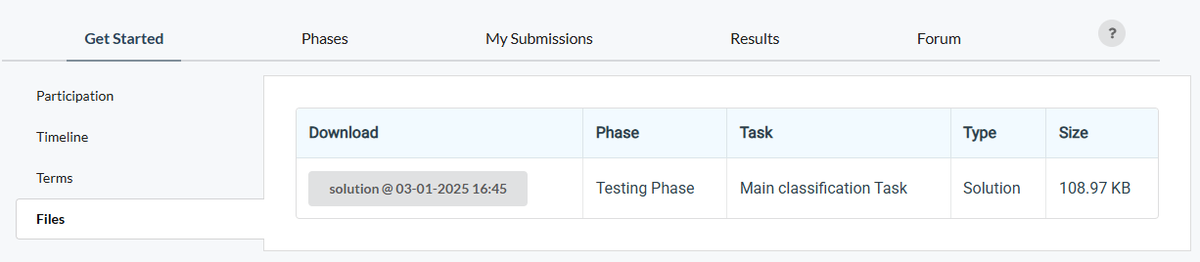
How to participate the competition and do submission
Register an account on CodaBench
When registering the account, please use your studentID as the UserName
After you click the competition link, go to My Submissions, and join the competition
An “example” submission

Slide 5
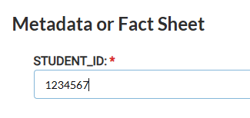
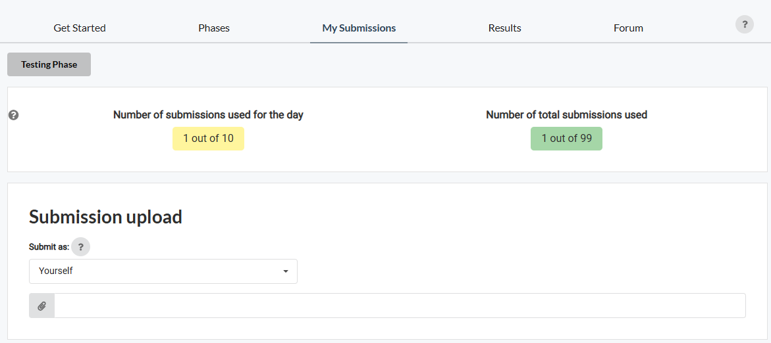
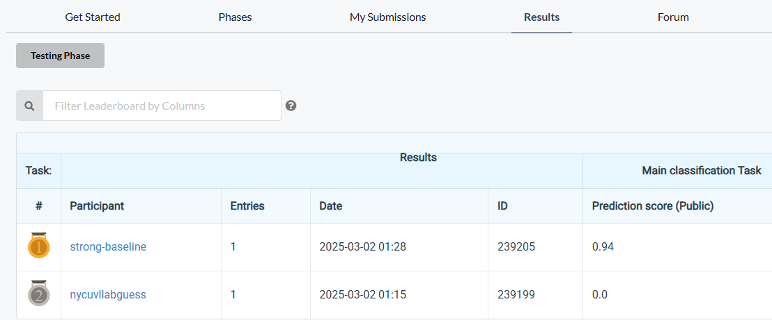
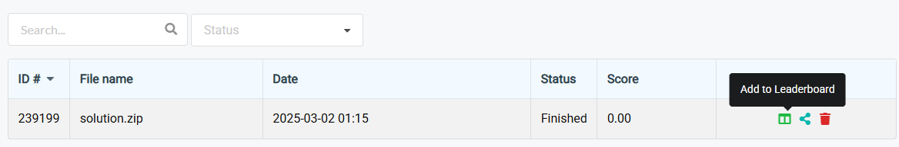
How to participate the competition and do submission
3. Submit your results and don’t forget to “Add to Leaderboard”
4. Don’t forget to check your results can be found on the leaderboard
No limitation for the name of the “zip” file; however, inside the zip file, your result files must be named “test-results.json”

Slide 6
Coding Environment
Recommnedation: Python 3.9 or higher
Tips
We recommend you to use virtual environments when implementing your homework assignments.
Here are some popular virtual environment management tools
Poetry
Conda
Virtualenv

Slide 7
Numpy & PyTorch
Numpy Tutorial: Link
PyTorch Tutorial: Link
Free to use any modules and functions

Slide 8
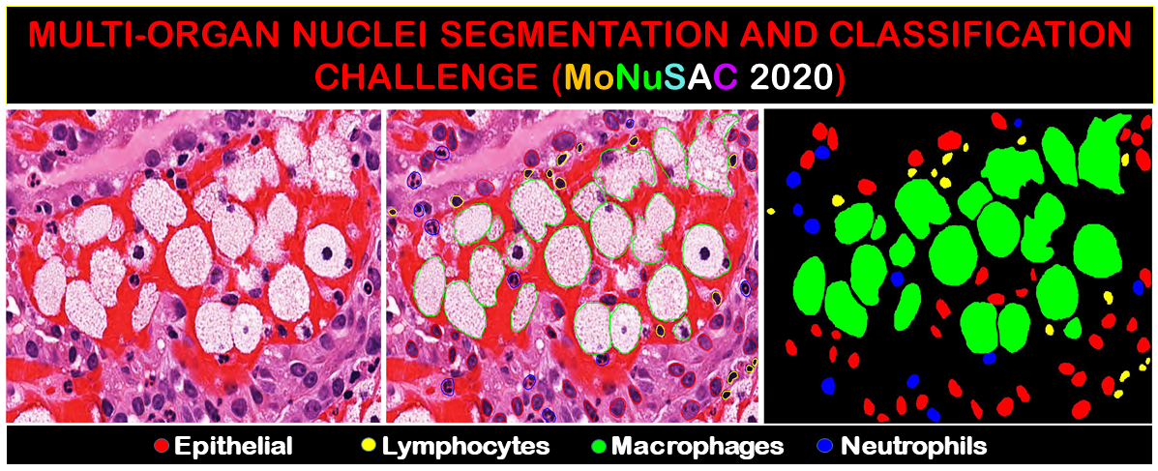
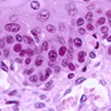
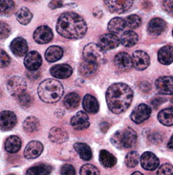
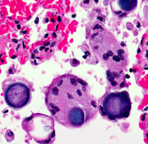
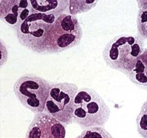
Task and Dataset
Task type: Instance Segmentation
Dataset
colored medical images
Training / Validation: 209 images
Test: 101 images
Target
Segmentation masks of 4 types of cells (class1, class2, class3, class4)

Slide 9
Task Requirement and Limitations
Requirement: Train instance segmentation models to segment target objects.
We provide you the raw image and masks in .tif format.
You need to process the data by yourself.
You need to convert predicted masks into correct submission format (example).
Limitations
No external data (i.e., data from other sources) is allowed.
Only pure vision-based model is allowed (No vision-language based model; No prompt-based model)
You can base on mask R-CNN to modify components/modules to improve the model performance.
You must “elaborate” (i.e., key design/contribution of that work) and “cite” the paper in the report.
Your model size (trainable parameters) should less than 200M.
Note: Pretrained weights (ImageNet) is allowed.

Slide 10
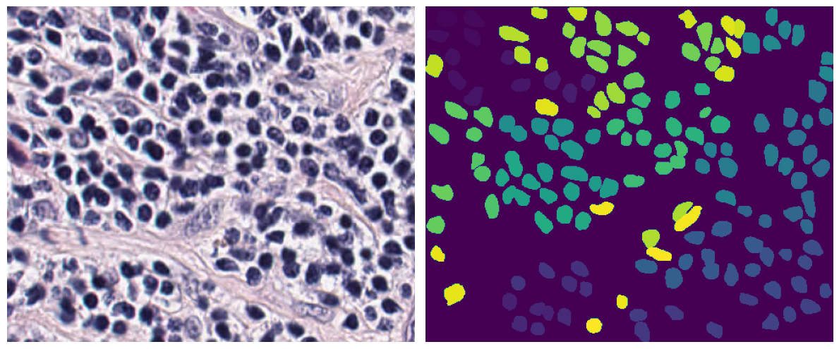
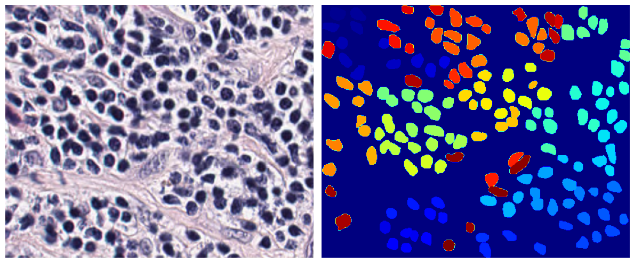
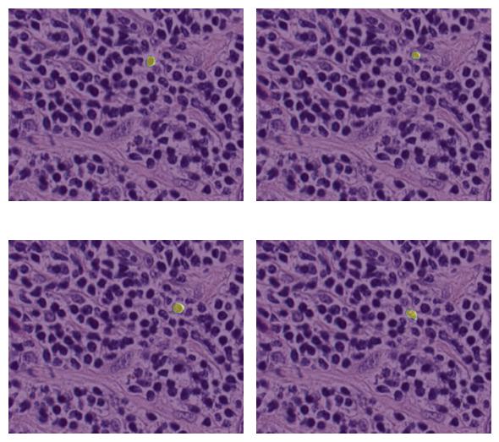
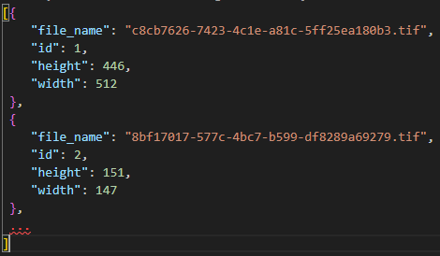
Dataset Inspection
train/
[image_name]
image.tif
class1.tif
class3.tif
…
test/
[image_name].tif
test_image_name_to_ids.json
Each unique pixel value represents an instance.
(e.g., mask == 1, mask == 2, mask == 3, mask == 4)
For you to generate submission file, you will need to map the filename to image_id

Slide 11
What you will learn from this homework
Know the key differences between detection and instance segmentation tasks.
How to process the instance data.
The concept of AP and how to evaluate the instance segmentation task.
How to generate the most common used result format - COCO format.

Slide 12
What you will learn from this homework
Know the key differences between detection and instance segmentation tasks.
How to process the instance data.
The concept of AP and how to evaluate the instance segmentation task.
How to generate the most common used result format - COCO format.

Slide 13
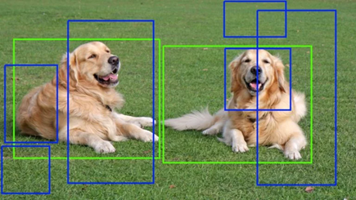
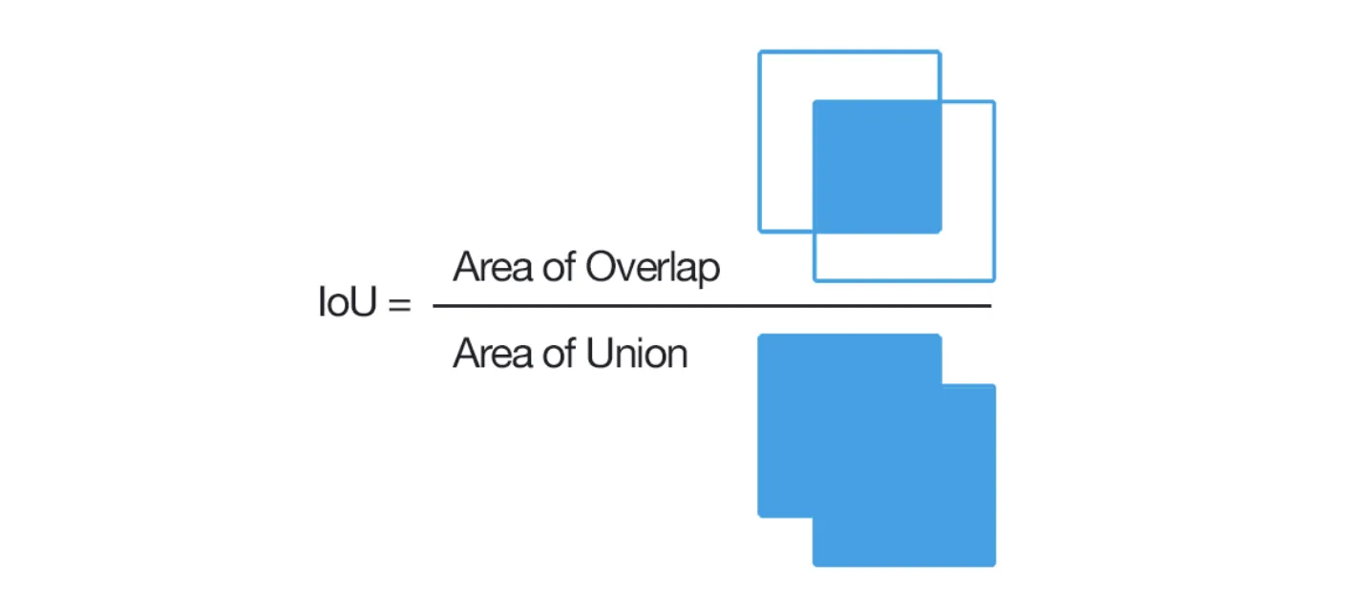
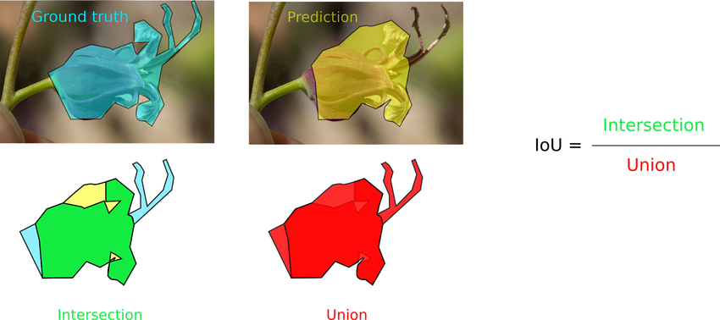
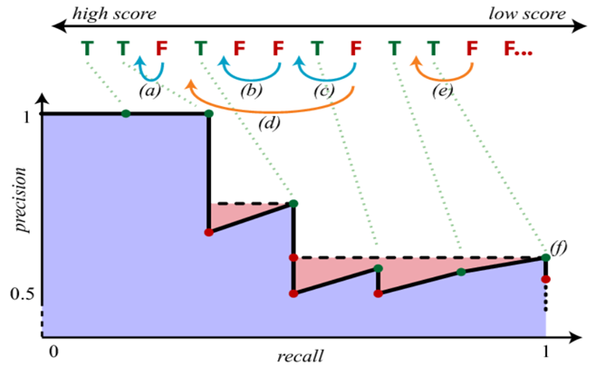
Average Precision (AP) in Instance Segmentation Task: Box → Mask
Compute the Intersection over Union (IoU) between prediction and ground-truth
Set a IoU threshold (e.g., 0.5) - Determine “Hit” or “Miss”
Based on prediction score (box/mask score), compute the recall and precision
Average over the precision under different recall score (Area over PR-Curve)
IoU in box format
IoU in instance format

Slide 14
AP in Instance Segmentation Task: Box → Mask (Use box as example)
Compute the Intersection over Union (IoU) between prediction and ground-truth (box or mask)
Set a IoU threshold (e.g., 0.5) - Determine “Hit” or “Miss”
P
N
P
P
N
N
N
N
P
P
N
N
Assume IoU threshold = 0.5
Assume IoU threshold = 0.75

Slide 15
AP in Instance Segmentation Task: Box → Mask (Use box as example)
Based on prediction score (box/mask score), compute the recall and precision
0.90
0.5
0.7
0.85
0.90
0.6
Assume IoU threshold = 0.5
IoU >= 0.5
IoU < 0.5

Slide 16
AP in Instance Segmentation Task: Box → Mask (Use box as example)
Based on prediction score (box/mask score), compute the recall and precision
Rank | IOU >= 0.5 | Prob | Precision | Recall
1 | T | 0.9 | 1.0 | 0.33
0.90
0.5
0.7
0.85
0.90
0.6
Assume IoU threshold = 0.5
Rank | IOU >= 0.5 | Prob | Precision | Recall
1 | T | 0.9 | 1.0 | 0.33
2 | T | 0.9 | 1.0 | 0.66
0.90
0.5
0.7
0.85
0.90
0.6
Assume IoU threshold = 0.5

Slide 17
AP in Instance Segmentation Task: Box → Mask (Use box as example)
Compute AP score
Rank | IOU >= 0.5 | Prob | Precision | Recall
1 | T | 0.9 | 1.0 | 0.33
2 | T | 0.9 | 1.0 | 0.66
3 | F | 0.85 | 0.67 | 0.67
0.90
0.5
0.7
0.85
0.90
0.6
Area: AP50
Assume IoU threshold = 0.5
Rank | IOU >= 0.5 | Prob | Precision | Recall
1 | T | 0.9 | 1.0 | 0.33
2 | T | 0.9 | 1.0 | 0.66
3 | F | 0.85 | 0.67 | 0.67
4 | T | 0.7 | 0.75 | 1.0
5 | F | 0.6 | 0.75 | 1.0
6 | F | 0.5 | 0.75 | 1.0
0.90
0.5
0.7
0.85
0.90
0.6
Assume IoU threshold = 0.5

Slide 18
What you will learn from this homework
Know the key differences between detection and instance segmentation tasks.
How to process the instance data.
The concept of AP and how to evaluate the instance segmentation task.
How to generate the most common used result format - COCO format.

Slide 19
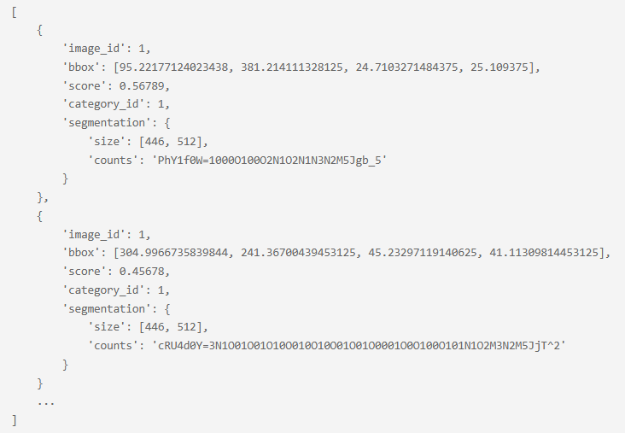
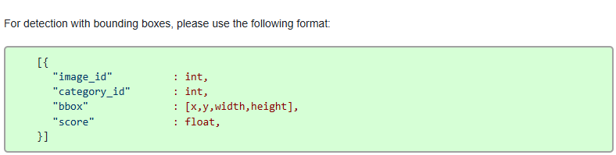
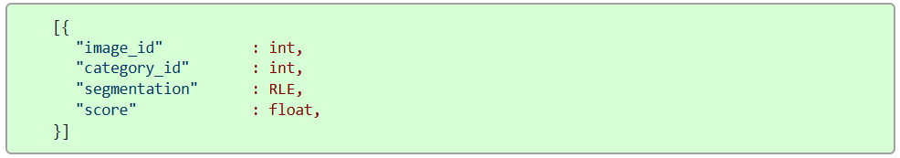
Output Format Example for Instance Segmentation
Official instruction
What is RLE format
Sample code for you to encode mask to RLE format
To prevent blind submission - Run evaluation by yourself before submitting (see COCOEval)

Slide 20
Grading Policy - Report (20%)
Format: PDF, written in English. (-5pts if not followed)
Sections that you should include
Introduction to the task and core idea of your method
Method: Descbible how you pre-process the data; what is your model architecture, and hyperparameters, etc.
You need to describe each key component in your model. (e.g., Backbone: ResNet, Neck: FPN, Heads: Mask/Transformer decode, etc.)
Results: Describe your findings and list/plot your model performance (e.g., training curve, confusion matrix, etc.)
References: Your method references (Paper / Github sources, must include if you use any.)
We encourage you to stand on the shoulders of giants - only clone repo and run it is not enough.
Among various architectures, why do you choose this one as your module? What are the pros and cons?
Additional experiments to explore better performance
Simply tuning the hyper-parameters doesn’t count (e.g., batch-size, LR, different optimizers)
Hint: Try to add/remove some layers, use different design, use different loss functions, etc.
You should 1) include your hypothesis (why you do this), 2) How this may (or may not) work, and 3) The experiment results and their implications.
15pts
5pts

Slide 21
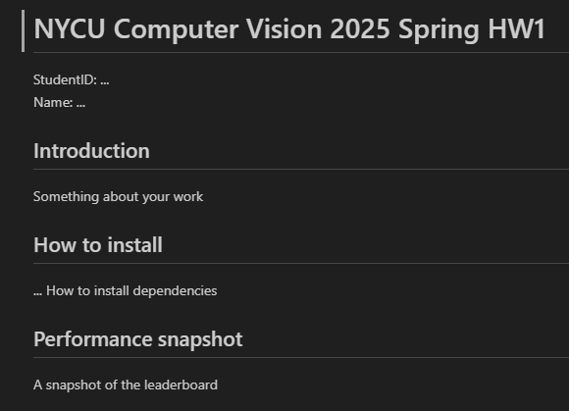
Grading Policy - Code Reliability (10%)
Python Coding Style Guide Reference
PEP8
Google Python Style
Please follow the PEP8 instructions and lint your code.
Push your code to the GitHub
It should contains a README.md to introduce this work (And your StudentID)
Runable codes
HW3
An example: README.md

Slide 22
Grading Policy (70%)
We will use private (hidden) leaderboard to evaluate the performance (the distribution is similar for data in public and private set.) The public leaderboard is for you as reference.
Your score (competinion):
Less than weak-baseline (AP50 < w.baseline): S = 0
Between weak-baseline and strong baseline (AP50 >= w.baseline & AP50 < s.baseline): (70 + (X - w.baseline) / (s.baseline - w.baseline) * (85 - 70)) * 0.70
Between strong-baseline and Rank3: (85 + (X - s.baseline) / (AP.rank3 - s.baseline) * (100 - 85)) * 0.70
Rank1,2,3 = 100 * 0.70
Raw score get
70
Interpolation
85
Interpolation
100
Your mAP
weak-baseline
(~0.15)
strong-baseline
(~0.231)
Rank-3
(Unknown)

Slide 23
Submission
Compress your code and report into a .zip file and submit it to E3.
Don’t forget to push your code to GitHub. And your GitHub link should be written in the report.
Report should be written in English.
<STUDENT ID>_HW3.zip
codes (.py, folders, etc)
<STUDENT ID>_HW3.pdf (NO .doc, .docx or others format)
Don’t put the data (e.g. x.jpg / train.csv / test.csv) and model checkpoints into submission file (-5 if not followed)

Slide 24
Other rules
Late Policy: A penalty of 20 points per additional late day. (-20pt / delayed.day)
For example, If you get 90 points but delay for two days, your will get only 50 points!
No Plagiarism: You should complete the assignment by yourself. Students engaged in plagiarism will be penalized heavily. Super serious penalty.
e.g. -100pt for the assignment or failed this course, etc
Report to academic integrity office

Slide 25
FAQs
Can I use any library/package/framework from GitHub or other resources?
Yes, we encourage you to learn how to leverage existing knowledge on your own task
e.g., Github of published works and model zoo from Torchvision
Focus on how to step forward from them - That’s why part of scores comes from your competition ranks
You should not copy-and-paste from your classmates (Plagiarism)
How to handle the GPU Out-of-Memory (OOM) issue?
Easy answer - Make your batch size smaller or make your model smaller.
Advanced methods: Try to figure it out by yourself. (Many online resources and AI-assistance)

Slide 26
FAQs
If I don’t have my own GPU – Use Google Colab
It should be 12 hours, please check this discussion in the stackoverflow
And some tricks here may make it longer.
If you have other questions, ask on E3 forum first! We will reply as soon as possible.

Slide 27

It’s your turn! Have Fun!

Slide 28
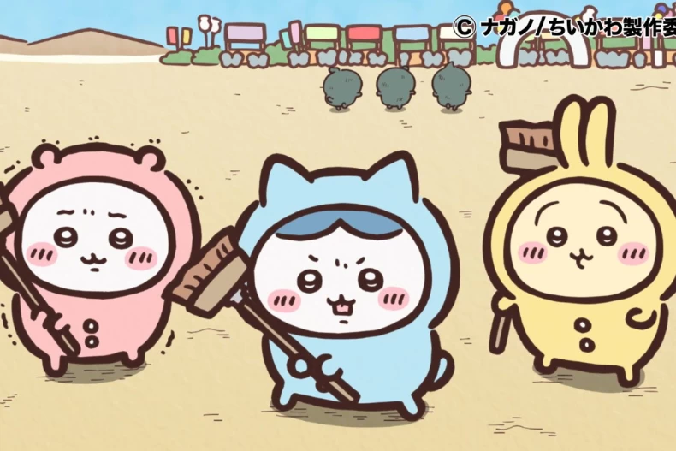
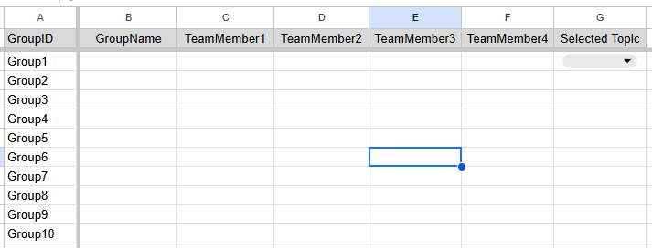
DONT FOGET: Team-up for the final project!
3/26 (Wed) - 4/23 (Wed) – After 4/24, we will random assign
Find 4 classmates to team up. [Link to the form]
“Team Member 1” will be the leader (We’ll contact leader when needed.)
Feel free to invite/join using E3 discussion board. (Just use homework discussion board)
Report order may be related to “topic” and in a random order - announce after the topic is selected.
[Student ID], [Your Name]
Topic will be released in the future.
Group Name
Can be either Chinese English
No affect to the grading

